Slide 1
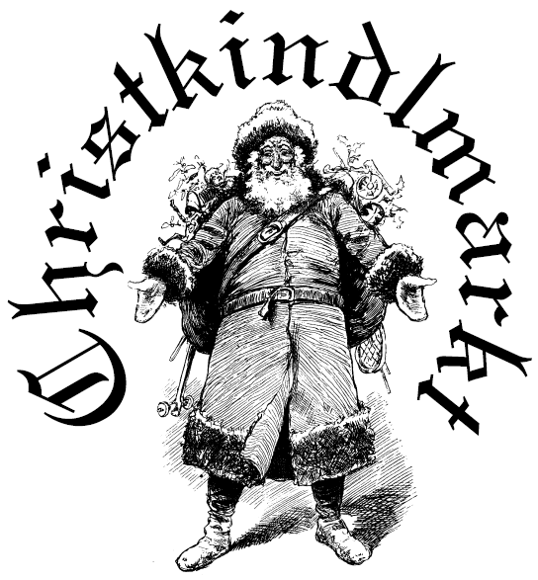
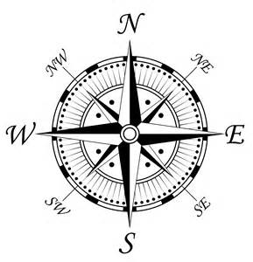
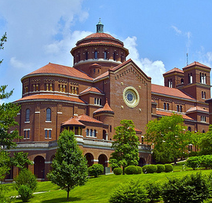
Antique
Emporium (202 E. 23rd St. A)
Markt Shuttle Routes
MARKT Sites
YMCA Antiques Market
Community Center
FPHS – 2 Gyms (Upper)
FPHS Cafeteria (Lower)
FPHS Commons (Lower)
American Legion
Ferdinand Elementary
Monastery Event Center
E. 23rd
Hwy
162
E. 20th
Northview
18th Street PARK
E. 18th
*
3
Walking/Driving
Map
Community Center
Vienna Drive
Main St.
Ferdinand
Library
SHUTTLE
SERVICE
HUB
FOREST PARK HIGH SCHOOL
*
2
W. 16th
YMCA
1
*
*
Ferdinand
House of
Flowers
1
E. 14th
St. Benedict’s Brew Works
W. 13th
E. 13th
Soup-N-Such Bistro
E. 12th
Monastery
Alabama
Monastery Event Hall & Gift Shop
E. 11th
Christkindlmarkt Bus Route 2019.pptx
Traditional
Arts Today
← 314 W. 9th
E. 10th
*
St. Ferdinand Church
E. 10th
2
Kundek
*
4
Ferdinand Elementary
W. 8th
E. 8th
FREE Shuttle Service
Main St.
Maryland
Carolina
Michigan
#
#
Shuttle Sequence
← 5th St. PARK
W. 5th
E. 5th
*
Markt Site (North Route)
*
Markt Site (South Route)
3
American Legion
Tin Lizzie’s
Home Décor
& Gifts
*
Walking Route
W. 4th
E. 4th
FREE Parking

